Slide 1
U
P
U
U
P
P
U
U
P
P
U
U
P
P

Slide 2
U
Components
P
U
U
P
P
U
U
P
P
U
U
P
P
7
1
2
Knucle cylinder
Pressure transduser
Knuckle counter balance valve block
Hawe directional control valve
Pump
Main counter balance valve block
Main cylinder
3
4
6
5

Slide 3
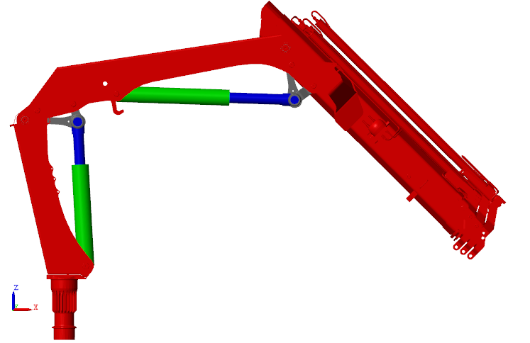
4
3
5
2
Column
Main cylinder
Knucle cylinder
Main arm
Knuckle arm
1

Slide 4
U
7
TwinCat
P
2
1
U
U
P
P
4
U
U
P
P
U
U
6
5
P
P
3
Pb1
Pb2
Pa1
Pa2
Pa3
Pa4
Pb3

